Slide 1
Suitable New Store Locations in Paris for a Fashion Retailer
Applied Data Science Capstone
Ankush P Lokhande

Slide 2
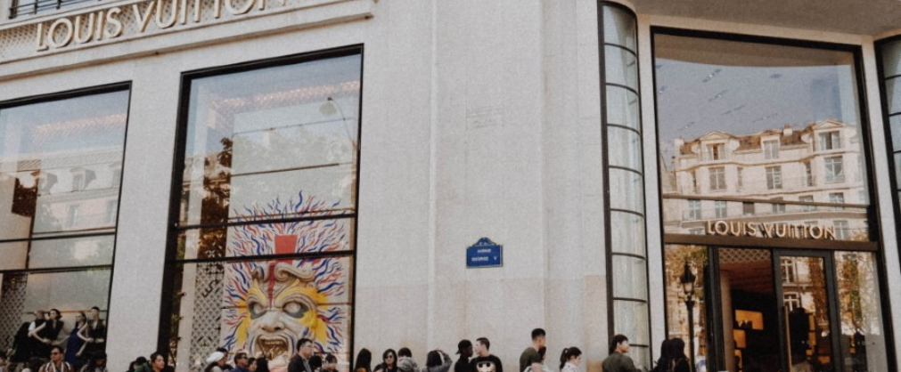
Ankush P Lokhande

Slide 3
Part1:ProblemDescription
A digitally native vertical fashion retailer, with a substantial e-commerce footprint, has begun the rollout of brick and mortar stores as part of their omnichannel retail strategy. After rolling out stores in a few select cities by guessing where the best locations were to open, as part of their store expansion for Paris they've decided to be more informed and selective , and take the time to do some research.

Slide 4
Part 2 Data Needed
Qualitative data from another retailer that they know, suggests that the best locations to open new fashion retail stores may not only be where other clothing is located. This data strongly suggests that the best places are in fact areas that are near French Restaurants, Cafés and Wine Bars. Parisians are very social people that frequent these place often, so opening new stores in these locations is becoming popular. The analysis and recommendations for new store locations will focus on general districts with these establishments, not on specific store addresses. Narrowing down the best district options derived from analysis allows for either further research to be conducted, advising agents of the chosen district, or on the ground searching for specific sites by the company's personnel.

Slide 5
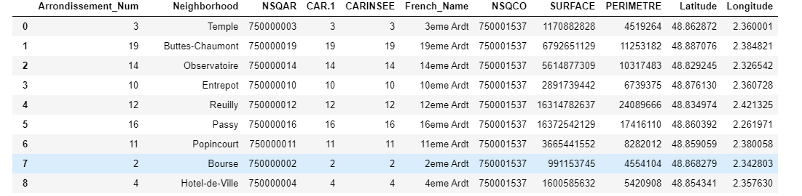
Foursquare Location

Slide 6
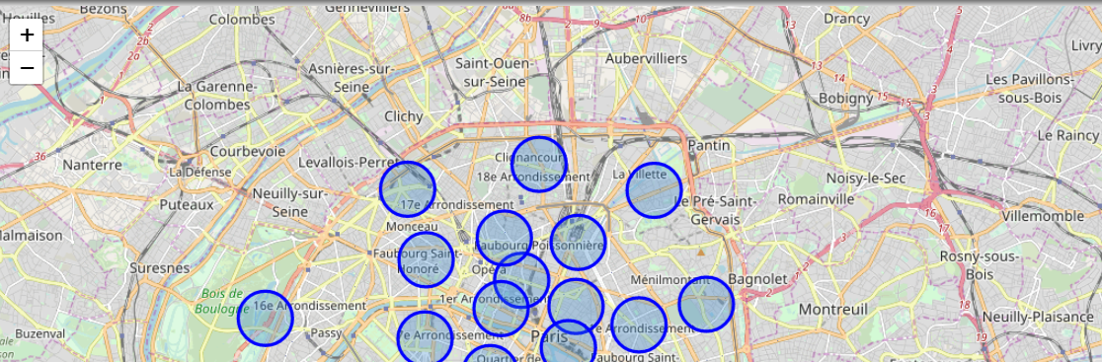
Map of Paris using Longitude and Latitude

Slide 7
Part 2: Connecting to Foursquare and Retrieving Locational Data for Each Venue in Every Neighborhood
After finding the list of neighborhoods, we then connect to the Foursquare API to gather information about venues inside each and every neighborhood. For each neighborhood, we have chosen the radius to be 500 meter. It means that we have asked Foursquare to find venues that are at most 500 meter far from the center of the neighborhood.

Slide 8
Part 3: Processing the Retrieved Data and Creating a Data Frame for All the Venues inside When the data is completely gathered, we will perform processing on that raw data to find our desirable features for each venue. Our main feature is the category of that venue. After this stage, the column "Venue's Category" will be One-hot encoded and different venues will have different feature-columns. After On-hot encoding we will integrate all restaurant columns to one column "Total Restaurants" and all food joint columns to "Total Joints" column.

Slide 9
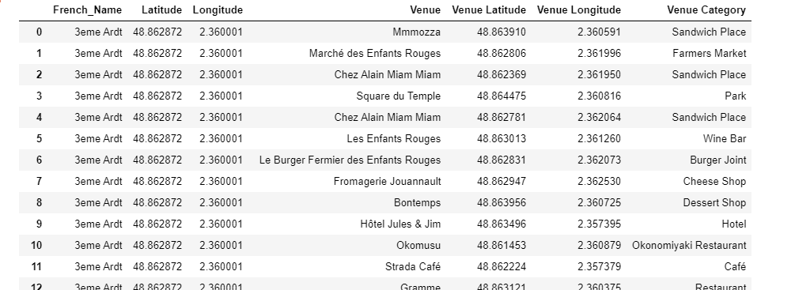
Processing retrieved data

Slide 10
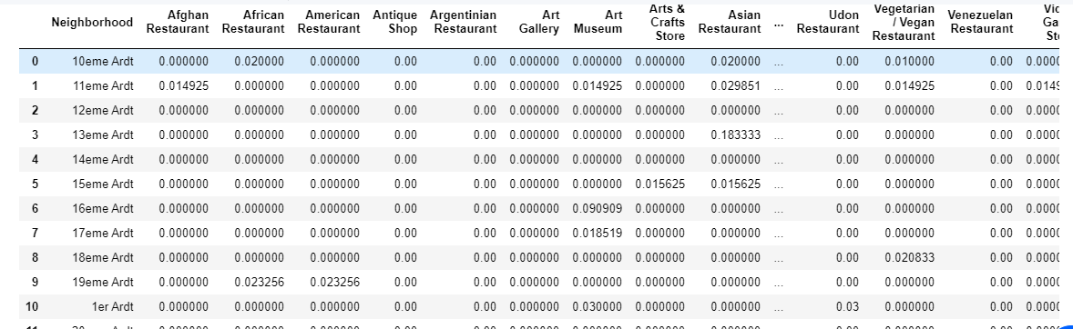
Data Ready..

Slide 11
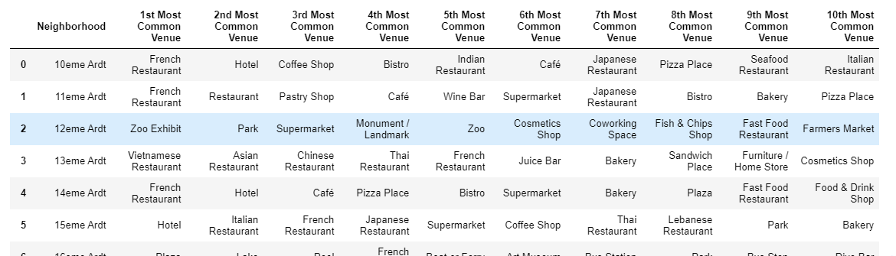
Top Ten Venues

Slide 12
Chosen Neighborhoods - Results
Inferential analysis using the data, as well as domain knowledge of retail and marketing, allow the list to be focused to just 3 neighborhoods from the previous 8.
The reasoning being that if the 3 criteria have been met - identifying neighborhoods that are lively with Restaurants, Cafés and Wine Bars - adding Clothing Stores into the mix of stores in the area is a significant bonus. Having some of the same category of stores in the same area - especially in fashion retail - is very desirable as a retailer.
So we can increase the criteria to include Restaurants, Cafés, Wine Bars and Clothing Stores - which narrows down and focuses the suggested districts for new stores to be located, and at the same time provides better locations for the brand.
So the final 3 prospective neighborhoods for new store locations are where 4 criteria are met:
- 3eme Ardt : Arrondissement 3, Temple
- 4eme Ardt : Arrondissement 4, Hotel-de-Ville
- 6eme Ardt : Arrondissement 6, Luxembourg

Slide 13
THANK YOU

